Slide 2
Virtual Environments
Virtual environment in a Python FastAPI project is essentially a self-contained workspace where you install and manage dependencies (libraries, frameworks, tools) without interfering with your system-wide Python installation.
Think of it as a sandbox that keeps the project clean, reproducible, and isolated.
Virtual environment ensures these dependencies are scoped to your project only, making it easier to maintain and deploy.
Guarantees that your app runs consistently across local dev, Docker, and CI/CD pipelines by isolating dependencies.
Virtual environment is a directory with some files in it.

Slide 3
Key features
Isolation: Each FastAPI project can have its own set of packages and versions.
Example: One project may use FastAPI==0.115.0, another may use FastAPI==0.95.0, and they won’t conflict.
Reproducibility: Ensures that when you share your project (via requirements.txt), others can recreate the exact same environment.
Portability: Works seamlessly with Docker, CI/CD pipelines, and cloud deployments.
Safety: Prevents “dependency hell” where different projects overwrite each other’s libraries.

Slide 4
Virtual Environments
Create a Project
  First, create a directory for your project.
Create a Virtual Environment
  When you start working on a Python project for the first time, create a virtual environment inside your project.
  only need to do this once per project, not every time you work.
  To create a virtual environment, you can use the venv module that comes with Python.

Slide 5
Using venv (built-in with Python)
Run these commands in your project root:
# Create a virtual environment named 'venv'
python -m venv venv
# Activate it (Linux/Mac)
source venv/bin/activate
# Activate it (Windows PowerShell)
venv\Scripts\Activate.ps1
# Activate it (Windows CMD)
venv\Scripts\activate.bat
Once activated, your shell prompt will show (venv) — meaning you’re inside the virtual environment.

Slide 6
Install Dependencies
Inside the activated environment:
pip install --upgrade pip
pip install fastapi uvicorn
If you have a requirements.txt:
pip install -r requirements.txt
Run Your FastAPI Project With the environment active:
uvicorn app.main:app --reload

Slide 7
(Optional) Using virtualenv or pipenv
virtualenv (older but still popular):
pip install virtualenv virtualenv venv source venv/bin/activate
pipenv (manages both venv + dependencies):
pip install pipenv pipenv install fastapi uvicorn pipenv shell
Best Practice
Keep your venv/ folder out of version control by adding it to .gitignore.
Always document activation steps in your README.md so teammates can replicate easily.

Slide 8
Virtual environment workflow with Docker
Combine virtual environment workflow with Docker to get reproducible builds and don’t have to manually activate environments when deploying.
Why Combine venv + Docker?
Local dev: Use venv to isolate dependencies while coding.
Deployment: Docker ensures the same environment runs everywhere (CI/CD, cloud, teammates’ machines).
Best practice: Keep venv for local development, but let Docker handle environments in production.

Slide 9
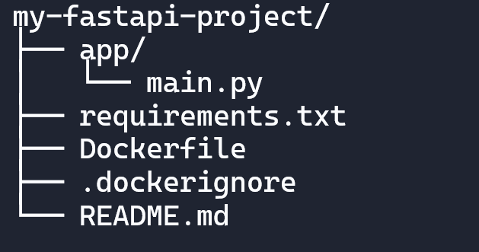
Project Structure

Slide 10
Step 1: Dockerfile
Instead of copying your local venv, Docker creates its own isolated environment:
# Base image
FROM python:3.11-slim
# Set working directory
WORKDIR /app
# Install dependencies
COPY requirements.txt .
RUN pip install --no-cache-dir -r requirements.txt
# Copy project files
COPY . .
# Expose FastAPI port
EXPOSE 8000
# Run FastAPI
CMD ["uvicorn", "app.main:app", "--host", "0.0.0.0", "--port", "8000"]

Slide 11
Step 2: .dockerignore
Prevent unnecessary files (like your local venv) from bloating the image:
venv/
__pycache__/
*.pyc
*.pyo
*.pyd
.env
.git

Slide 12
Step 3: Build & Run
# Build image
docker build -t fastapi-app .
# Run container
docker run -d -p 8000:8000 fastapi-app

Slide 13
Step 4: Local Dev vs Docker
Local dev:
python -m venv venv
source venv/bin/activate
pip install -r requirements.txt
uvicorn app.main:app --reload

Slide 14
Step 4: Local Dev vs Docker
Production (Docker):
docker build -t fastapi-app .
docker run -d -p 8000:8000 fastapi-app

Slide 15
Best practices
- Use venv for local development convenience.
- Use Docker for deployment and CI/CD consistency.
- Never copy your local venv into Docker — let Docker rebuild dependencies from requirements.txt.

Slide 16
Scaffold a FastAPI project
Can use a CLI tool called fastapi-project-creator to automatically scaffold a FastAPI project with a best-practice folder structure.
pip install fastapi-project-creator
Create a new project:
create-fastapi-app my-project-name
- This generates a ready-to-use FastAPI project with:
  - Organized directory structure
  - Pre-configured API routers (controllers & services)
  - Database connection setup (SQLAlchemy)
  - Environment variable configuration
  - Proper entry point (main.py)

Slide 17
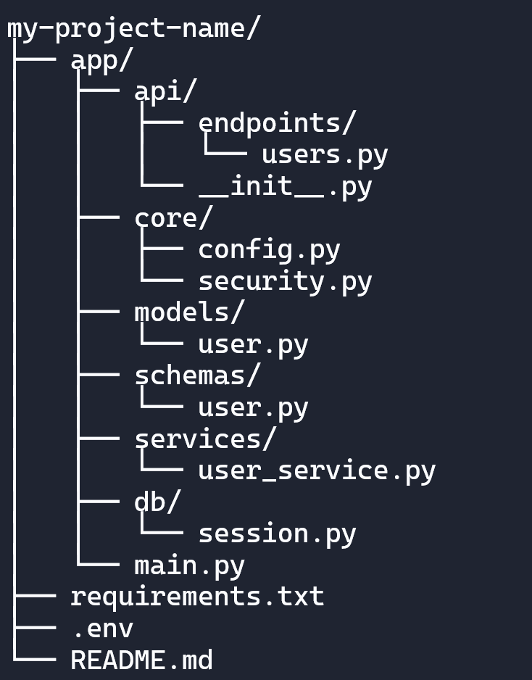
Example Folder Structure

Slide 18
requirements.txt
File plays a critical role in any Python project, including FastAPI.
Think of it as the blueprint for your project’s dependencies.
Dependency Management
Lists all the Python packages (and their versions) your FastAPI project needs to run.
Reproducibility
Ensures that anyone (including CI/CD pipelines, Docker builds, or teammates) can recreate the same environment by running:
  pip install -r requirements.txt
Portability
Makes your project portable across machines, servers, and cloud deployments. Without it, others would have to guess which packages you used.
Version Control
Pinning versions (package==x.y.z) avoids “works on my machine” issues by locking dependencies to tested versions.

Slide 19
Example of requirements.txt
fastapi==0.115.0
uvicorn==0.32.0
sqlalchemy==2.0.23
python-dotenv==1.0.0
Requirements.txt is the contract between your FastAPI project and its environment.
Guarantees that your app runs the same way everywhere — locally, in Docker, and in CI/CD pipelines.

Slide 20
Why requirements.txt is Important in FastAPI Projects
FastAPI projects often rely on multiple libraries:
  Web server: uvicorn or hypercorn
  Database: sqlalchemy, psycopg2, tortoise-orm
  Auth/security: python-jose, passlib
  Environment config: python-dotenv
  Testing: pytest, httpx
Having them in requirements.txt ensures:
Docker builds install the exact same dependencies.
GitHub Actions CI/CD pipeline can run tests consistently.
Teammates can onboard quickly without manual setup.

Slide 21
Workflow Example
During development, install packages:
pip install fastapi uvicorn sqlalchemy
Freeze dependencies:
pip freeze > requirements.txt
Share the project → others just run:
pip install -r requirements.txt

Slide 22
Ways to create requirements.txt
1. Manual Creation
If you already know the dependencies, can simply create a file named requirements.txt in your project root and list them:
fastapi
uvicorn[standard]
sqlalchemy
psycopg2-binary
python-dotenv
Then install them with:
pip install -r requirements.txt

Slide 23
Ways to create requirements.txt
2. Auto-Generate with pip freeze
If you’ve already installed packages in your virtual environment, you can generate requirements.txt automatically:
# Activate your virtual environment first
source venv/bin/activate # Linux/Mac
venv\Scripts\Activate.ps1 # Windows PowerShell
# Generate requirements.txt
pip freeze > requirements.txt
This will capture all installed packages (including versions) in your environment.
Example output:
fastapi==0.115.0
uvicorn==0.32.0
sqlalchemy==2.0.23
python-dotenv==1.0.0

Slide 24
Ways to create requirements.txt
3. Use pip-tools for managing dependencies:
pip install pip-tools
pip-compile
- This generates a clean, version-pinned requirements.txt from a simpler requirements.in.

Slide 25
Ways to create requirements.txt
4. Built-in Tools- pipreqs
scans your project imports and generates requirements.txt only for packages you actually use:
pip install pipreqs
pipreqs ./ --force

Slide 26
Best Practices
- Pin versions: Always include exact versions (package==x.y.z) for reproducibility.
- Minimal list: Avoid dumping unnecessary packages (e.g., dev tools) into production requirements.
- Use separate files:
  - requirements.txt → production
  - requirements-dev.txt → testing, linting, etc.
In short:- Use pip freeze > requirements.txt if you want a snapshot of your current environment.
- Use pipreqs if you want a clean file based only on imports in your code.
- For enterprise projects (like your FastAPI + OBDX integration),use pip-tools to keep dependencies tidy and pinned.

